Slide 1

Streamlining The Design And Implementation Process of Dynamic Three-Dimensional Game Development
LOCHLANN O NEILL
R00175741
SDH4
19 May 2023

Slide 2








Background
Lifelong passion for gaming
Software Development
Game Development
Notes:
• Be very succinct in the project introduction. • Use diagrams where possible. • Don’t read from the slides. • Time is of the essence. • Get to Implementation and Challenges as quickly as possible.

Slide 3
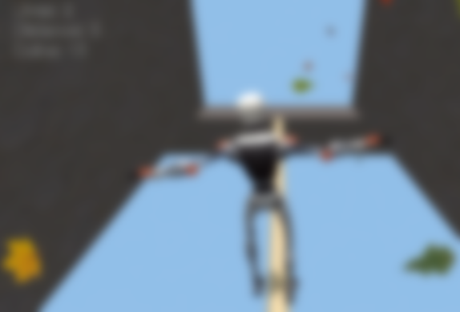
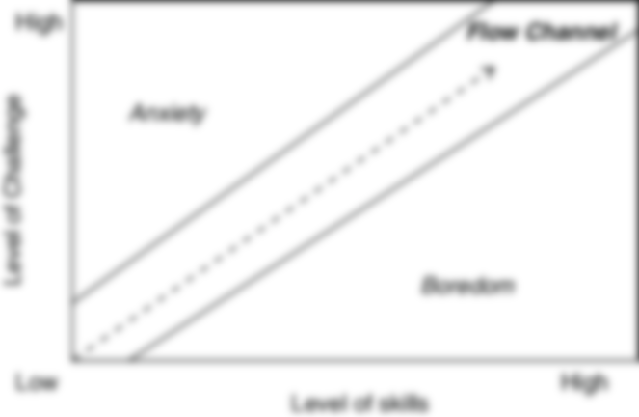

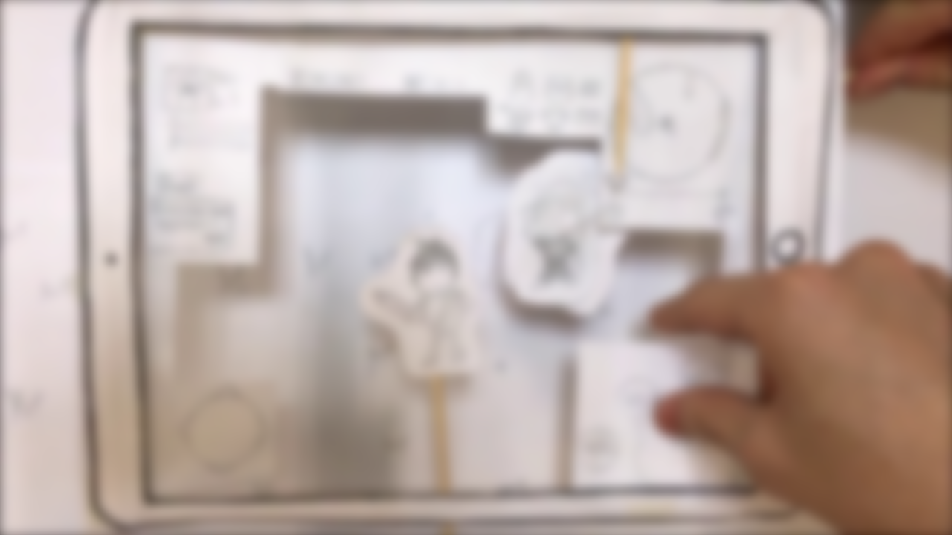
Goal & Objective
Comprehensive and practical streamlined guideline
Educate new developers
Provide fully-functional and scalable template
The design process - idea generation, play context, MDA
Adhere to prototypes (Roughly)
Agile – sprints, document progress, version control

Slide 4
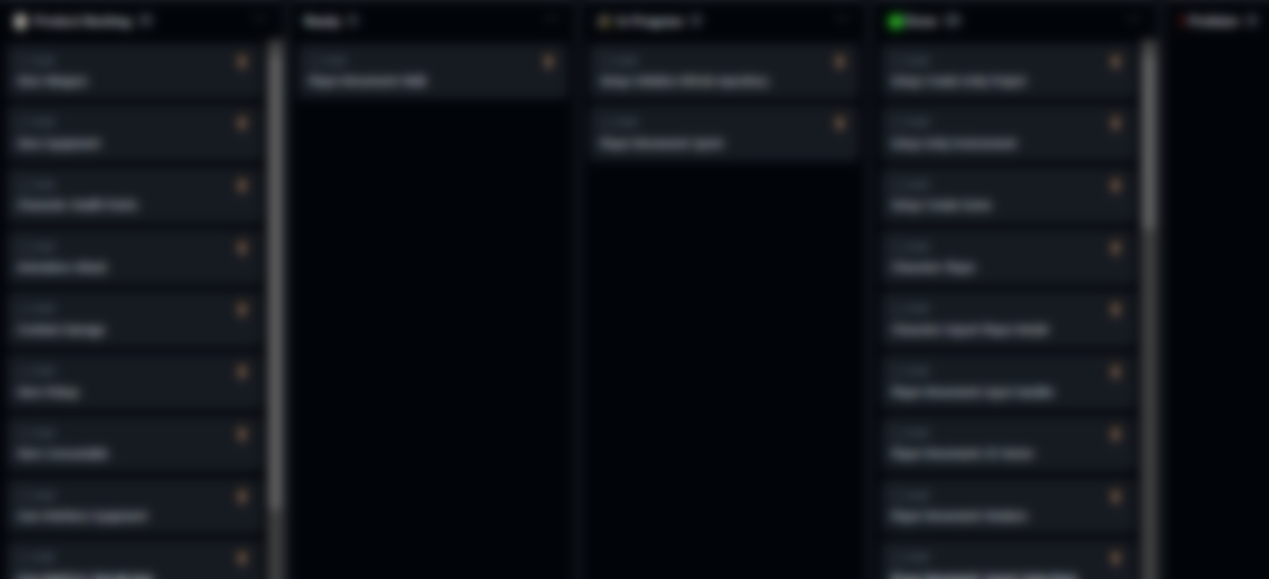
Requirements
Functional
Non-Functional
Object Interaction
Character Statistics
Movement
Camera
Items / Inventory
Compass
Animations
3D Art
Combat
Compass
Performance
Scalability
Maintainability
Aesthetics
User Experience

Slide 5
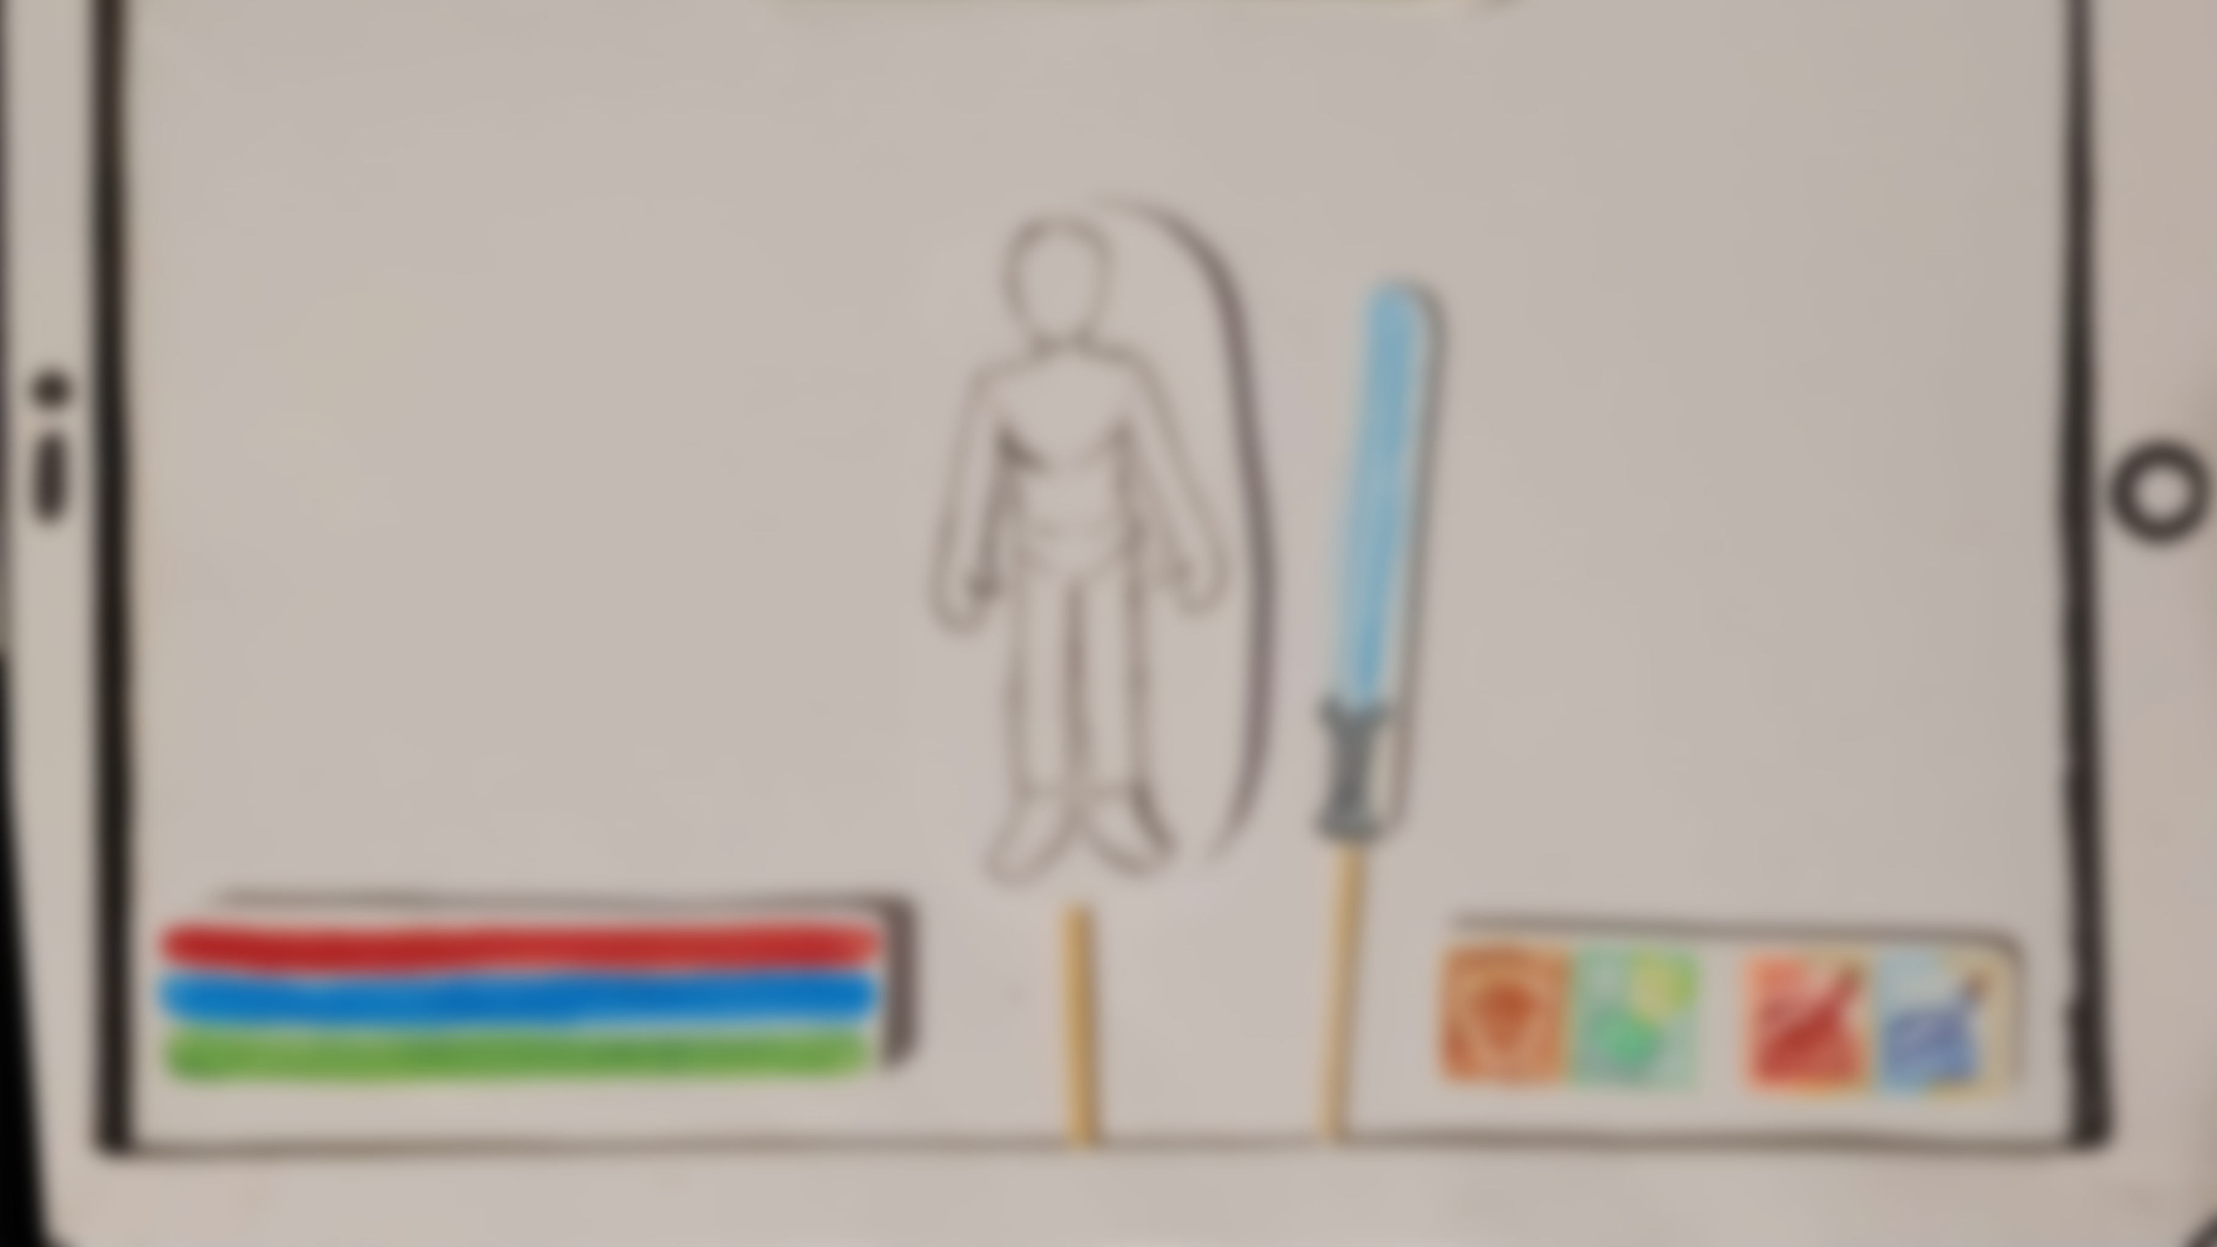
Paper Prototypes
User Interface Components
Interactivity Concepts
Mechanics

Slide 6
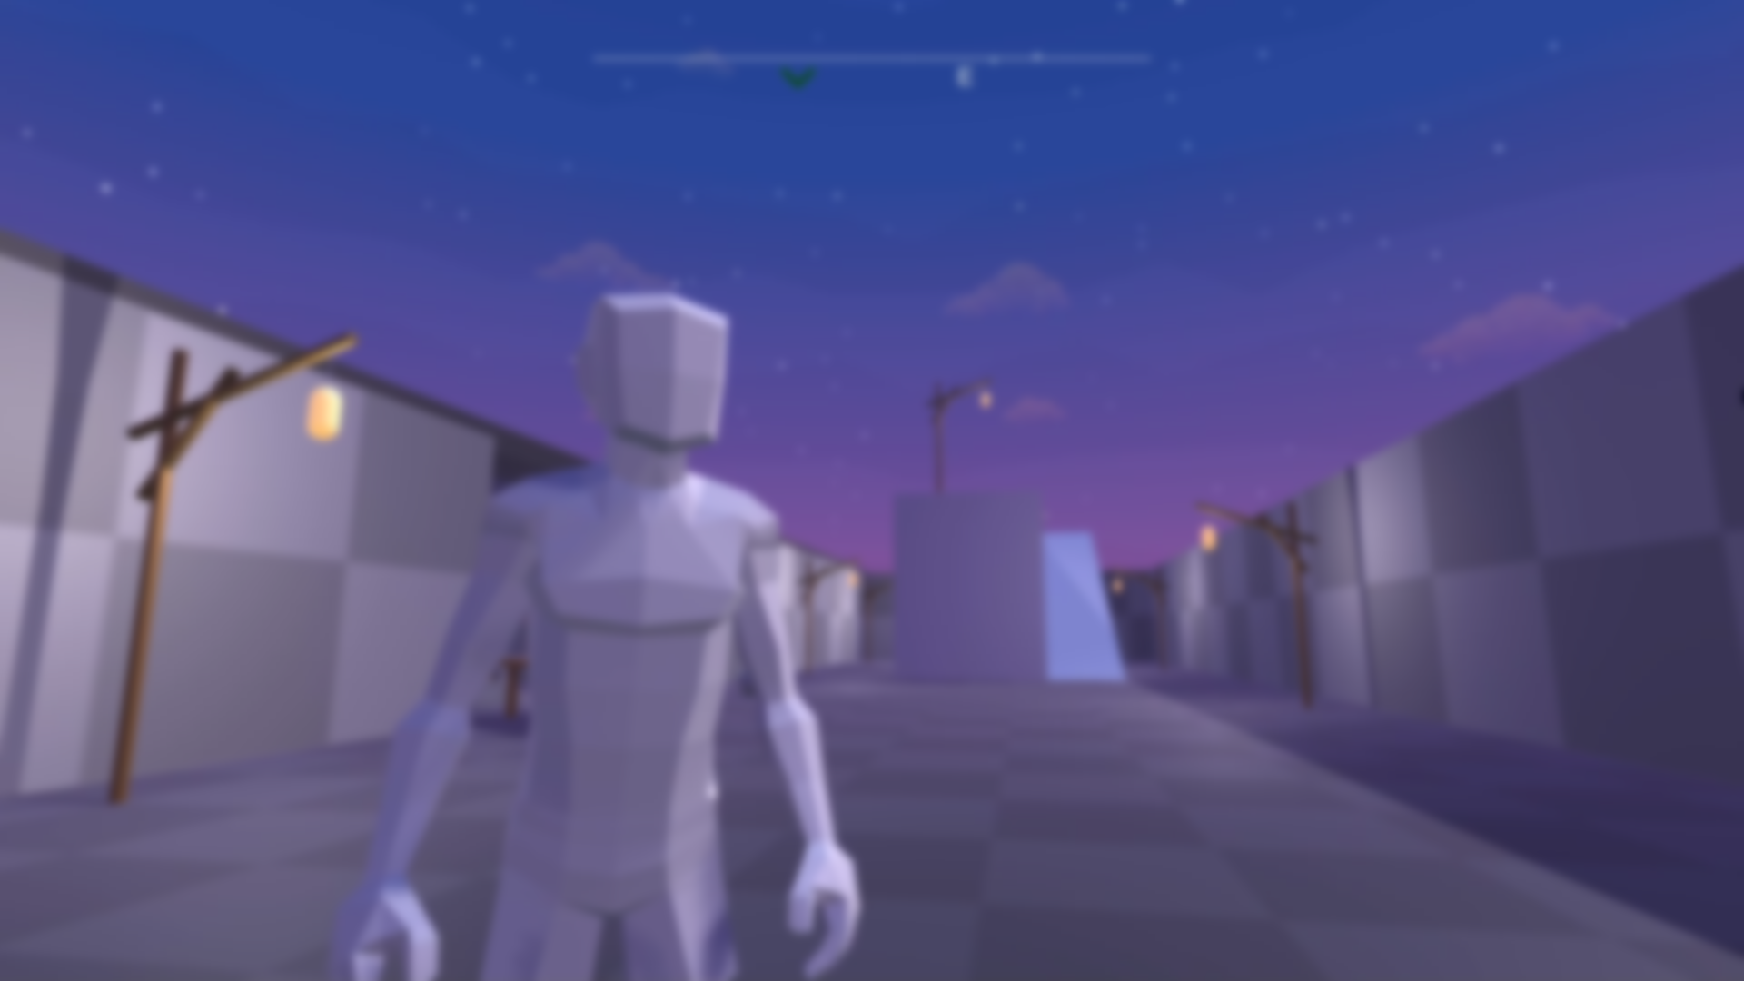
Video Demo
YouTube - https://youtu.be/FLddmNlQsmI
Github - https://github.com/lochlannoneill/INTR8016-FinalYearProject

Slide 7
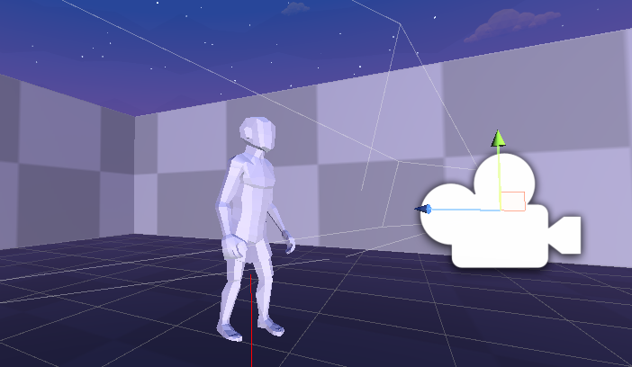
Camera
Following
Rotation
Pivot angle
SphereCast
Collision Colliders
Linear Interpolation (Lerp)

Slide 8
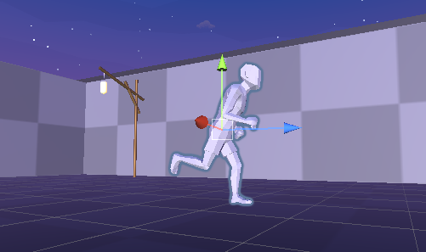
Movement
Input System
Action Mapping
Locomotion
Rotation
Animations (Blend Tree – Walking, Running, Sprinting)

Slide 9
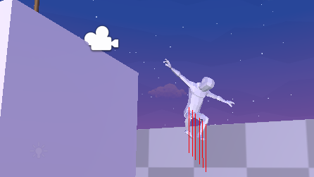
Falling
Raycasting
Flagging
Linear Interpolation (Lerp)

Slide 10
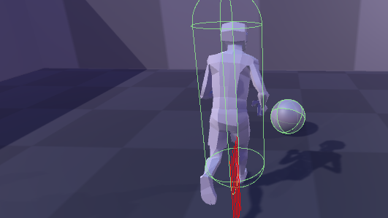
Object Interaction
Rigidbodies
Collision Colliders
Relative Mass

Slide 11
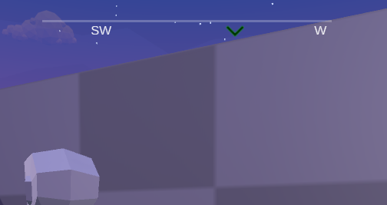
Compass
User Interface (HUD)
Cardinal Markers
Objective
Clamping
Threshold

Slide 12
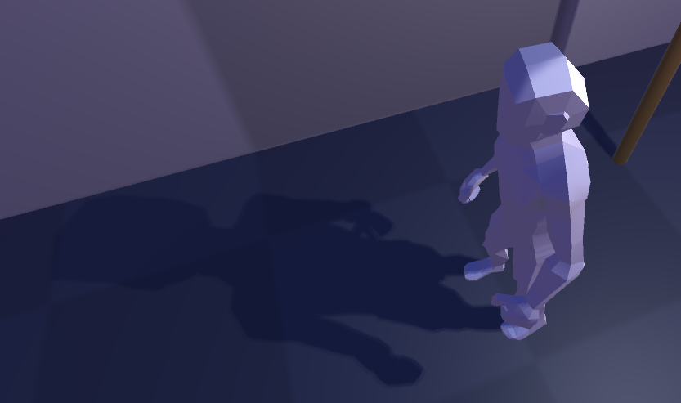
Environment
Prefabs
Lighting
Skybox
Background Music

Slide 13
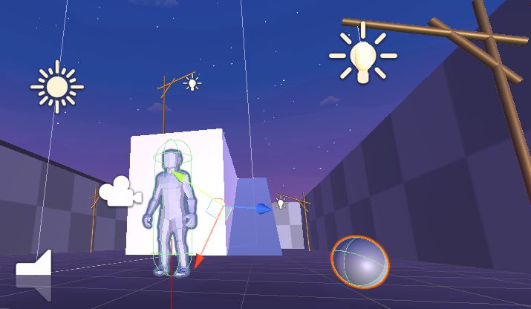
Testing
Gizmos
Debug Lines
Collision Colliders
XYZ Axis

Slide 14
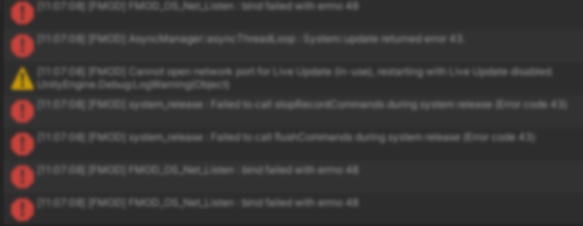
Challenges
Hardware Limitations
Failing to push large file to GitHub
Non-stopping moving animation
Architectural Spaghetti Code
Scope Creep (Combat, Items, Statistics)
Falling

Slide 15

Requirements Evaluation
Functional
Non-Functional
Character Objects - Successful
Character Statistics - Unsuccessful
Movement - Successful
Camera - Successful
Items / Inventory - Unsuccessful
Compass - Successful
Animations - Successful
3D Art – Successful
Combat – Unsuccessful
Compass – Successful
Performance – Successful
Scalability - Successful
Maintainability – Successful
Aesthetics- Successful
User Experience- Successful

Slide 16

Potential Future Enhancements
Zoom In/Out - Easy
Walking - Easy
Movement Audio - Medium
Character Statistics - Medium
Item Manager - Difficult
Inventory – Difficult
Combat – Difficult
Quests – Very Difficult
AI Finite State Machines – Very Difficult
Game State Persistence – Very Difficult

Slide 17
Conclusions
Game template was designed
Initial Requirements
Functionality Implemented
Scope management – mitigating unexpected challenges
Planning, time management, task prioritization

Slide 18
Questions ?

Slide 19
PROJECT INTRODUCTION 5 MINUTES MAX
• Project Background • Project Goal and Objectives • Project Requirements(/Deliverables)Project Design • Project Implementation • Project Challenges • (Project Updated Design) • (Project Updated Implementation)
• Be very succinct in the project introduction. • Use diagrams where possible. • Don’t read from the slides. • Time is of the essence. • Get to Implementation and Challenges as quickly as possible.

Slide 20
PROJECT DISCUSSION AND EVALUATION 5-10 MINUTES
• Project Testing • Project Evaluation • Future Enhancements • Project Conclusions
• Did the project meet the goals and objectives? • Did you get the project requirements, design and implementation right? • Knowing what you do now, what would you do differently? • What would you do to improve the project? • What did you learn from the experience?

